Slide 1
CSE315:Introduction to Data Science Fall 2024
Introduction to Statistics and Sampling Methods
WEEK-2
Lesson 2

Slide 2
Statistics and its types
Statistics is the scientific study of techniques for collecting, organizing, Presenting, analyzing and drawing conclusions from data.
Types of Statistics – Descriptive Statistics and Inferential Statistics.
Descriptive Statistics: methods of organizing, summarizing, and presenting data in an informative way.
Inferential Statistics: A decision, estimate, prediction, or generalization about a population, based on a sample.

Slide 3
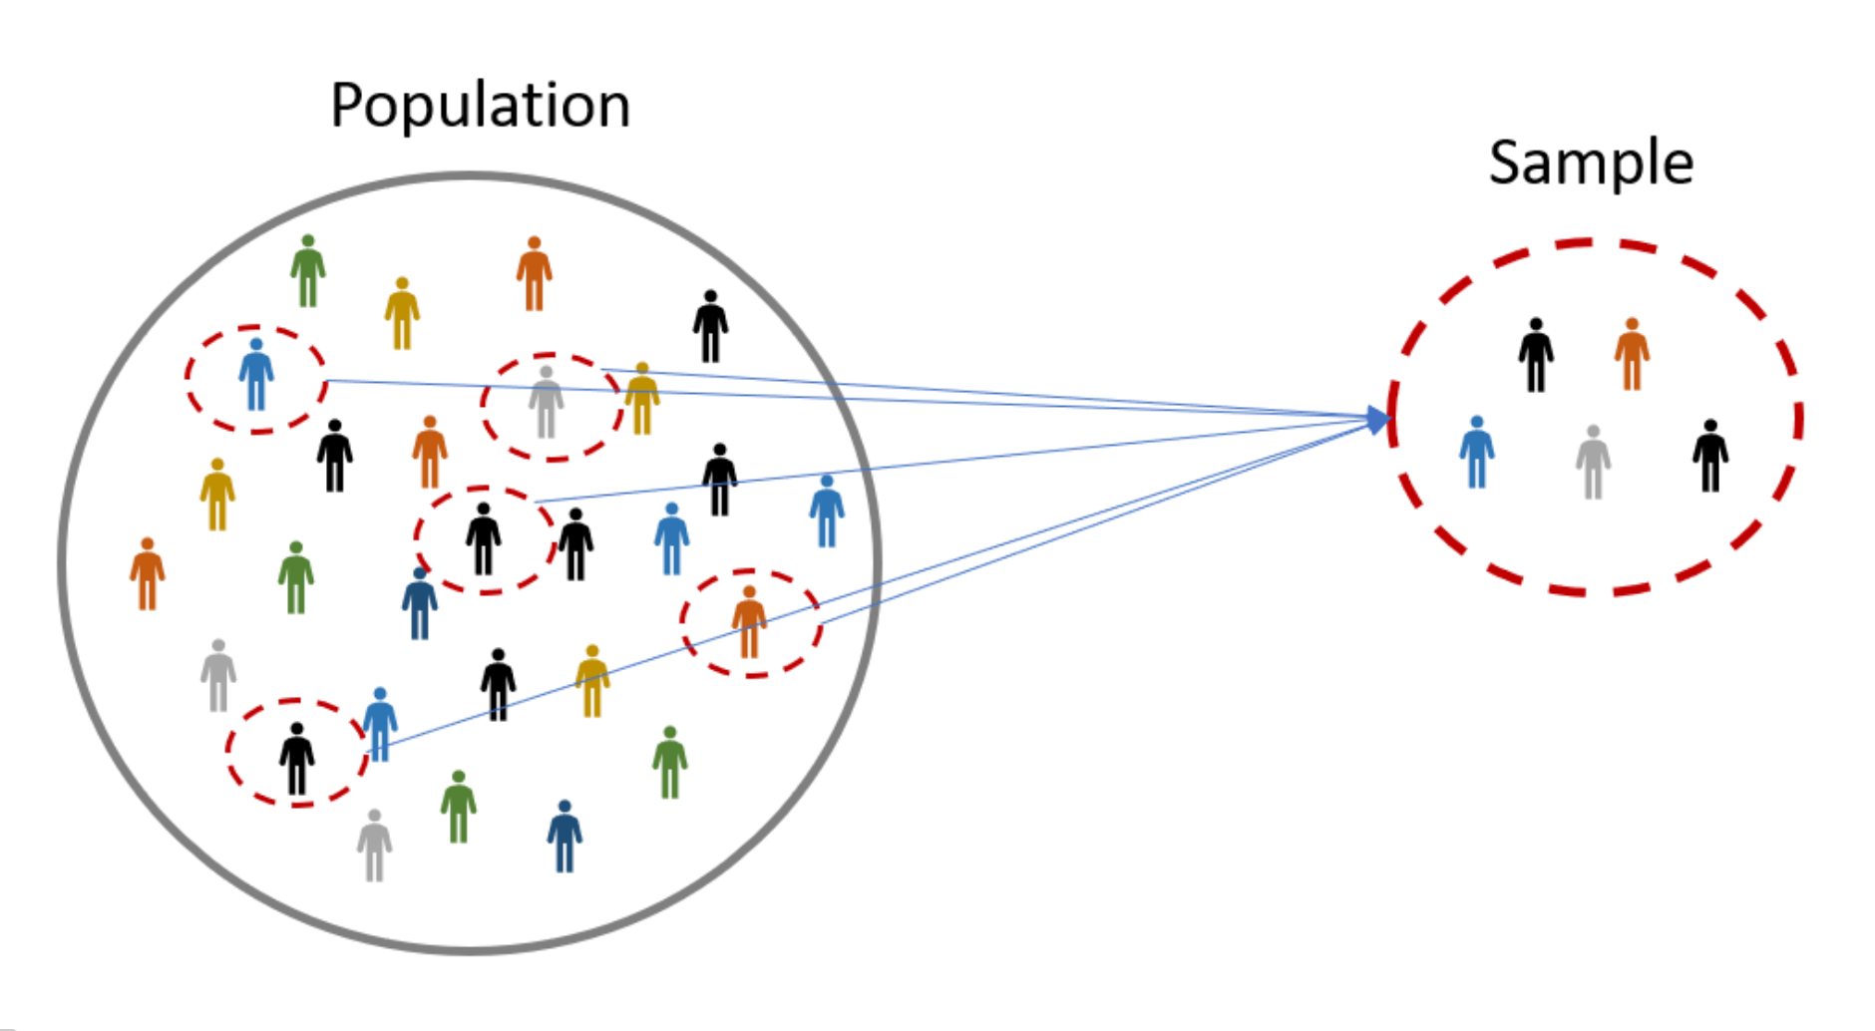
Population and Sample
A population is a collection of all possible individuals, objects, or measurements of interest.
A sample is a representative portion, or part, of the population of interest

Slide 4
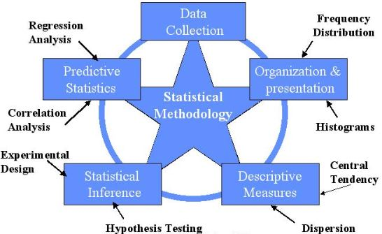
Statistical Methodology
Statistical methods are procedures for drawing conclusions about populations utilizing information provided by random samples

Slide 5
Necessity of Sampling
Suppose you want to know the average salary of all the IT professionals in Bangladesh, that is, all the IT professionals in Bangladesh are the population.
In that case you have to go to all the IT professionals in Bangladesh and find out their salary and the average that will be obtained from the data obtained will be the actual average.
When the data of all the members of the population is taken it is called census survey.
In fact, in most cases it is not possible to collect data from all members of the population. Because it requires a lot of time, manpower and money. That is why a small part representing the population is taken instead of the whole population.

Slide 6
Sampling techniques
Sampling techniques are methods used in statistics and research to select a representative portion of a population for analysis. The goal of sampling is to obtain a sample that is representative of the entire population.
Sampling techniques can be broadly categorized into probability and non- probability sampling.
Probability Sampling: In this approach, every member of the population has a known, non-zero chance of being selected. Probability sampling methods include:
Simple Random Sampling: Every member of the population has an equal chance of being selected.

Slide 7
Sampling Techniques (cont)
Systematic Sampling: Members are selected at regular intervals from an ordered list.
Stratified Sampling: The population is divided into strata (groups) based on shared characteristics, and members are randomly selected from each stratum.
Cluster Sampling (One and two stage): The population is divided into clusters (groups) that are randomly selected. All individuals in the chosen clusters are included in the sample.
When all the components inside a cluster are taken as samples it is a one stage cluster. Suppose each ward of Dhaka city is considered as a cluster, in which case samples of all the people of the ward will be taken in one stage cluster.
In the case of two stage clustering, instead of taking everyone inside a cluster as a sample, a certain number of samples are selected by following a simple random sampling method. In other words, we want to take data of 100 people from each cluster so 100 people will be selected again from each cluster through simple random sampling.

Slide 8
Non-Probability Sampling:
Non-Probability Sampling: These methods do not give all members of the population a known chance of being included in the sample.
Non-probability sampling methods include:
Convenience Sampling: Selection is based on availability and willingness to participate.
Judgmental or Purposive Sampling: The researcher selects participants based on their judgment about who would be most useful or representative.
Quota Sampling: Participants are selected to ensure that the sample represents certain characteristics in proportion to their prevalence in the population.
Snowball Sampling: Existing study subjects recruit future subjects from among their acquaintances.
The choice of sampling technique depends on the research objectives, the nature of the population, the resources available, and the level of precision required.

Slide 9
Uses of Sampling Methods
Probability sampling methods are generally preferred for quantitative research because they allow for the estimation of sampling error and thus more generalizable conclusions.
Non-probability sampling methods are often used in qualitative research, exploratory studies, or when a representative sample is difficult to achieve due to practical constraints.

Slide 10
Necessities of Sampling Methods
The use of sampling methods in research is essential for several reasons, particularly when dealing with large populations. Here are the key necessities of employing sampling methods:
Cost Efficiency, Time Efficiency, Practicality and Accessibility, Data Quality, Manageability, Statistical Significance, Ethical Considerations, Variability Insights.

Slide 11
Census and Survey Methods
Census is the process of collecting data from every member of a population
Sample Survey is the process of collecting data from a subset of a population.

Slide 12
Different sampling methods applied in real-life
Simple Random Sampling
Example: Customer Satisfaction Survey for a Small Business.
Situation: A local café wants to understand its customers' satisfaction levels to improve service. The café has a manageable customer base that visits regularly.
Application: The café owner generates a list of all customers from the loyalty program and selects a random sample using a random number generator. This subset of customers is then surveyed to gauge overall satisfaction.
Why SRS?: It gives each customer an equal chance of being selected, ensuring unbiased representation of the customer base.

Slide 13
Different sampling methods applied in real-life (Cont)
2. Stratified Sampling
Example: National Health Study on Smoking Habits.
Situation: A public health agency plans to study smoking habits among adults in the country. They aim to ensure that specific groups, such as age ranges and genders, are adequately represented.
Application: The population is divided into strata based on age and gender. A random sample is then drawn from each stratum proportional to its size in the overall population.
Why Stratified?: It ensures representation from all key demographic segments, improving the accuracy of estimates for the whole population and within each stratum.

Slide 14
Different sampling methods applied in real-life (Cont)
3. Cluster Sampling
Example: Educational Research in Schools.
Situation: An educational research organization wants to evaluate teaching methods across schools nationwide. It’s impractical to visit every school or survey every teacher due to resource constraints.
Application: Schools are grouped into clusters based on geography (e.g., by district). A random selection of these clusters is made, and all schools within these selected clusters are surveyed.
Why Cluster Sampling?: It reduces travel and administrative costs by focusing on a manageable number of geographic areas, although it may increase the sampling error compared to SRS.

Slide 15
Different sampling methods applied in real-life (Cont)
4. Systematic Sampling
Example: Quality Control in Manufacturing.
Situation: A manufacturing plant produces thousands of units of a product daily. The company wants to implement a quality control process that is both efficient and effective.
Application: The production line is set to produce a unit every few seconds. Quality control inspectors select every nth item coming off the production line for inspection (e.g., every 50th item).
Why Systematic?: This method ensures a spread-out sampling across the production batch and is simple to implement, providing a quick and consistent way to monitor product quality.

Slide 16
Drawing Random Sample
Steps of selecting random sample by random number table
Step 1: Assign Numbers to Population Members
Step 2: Select a Starting Point in the Random Number Table
Step 3: Determine Your Sample Size
Step 4: Read Off the Numbers
Step 5: Select Your Sample
Step 6: Continue Until Your Sample is Complete

Slide 17
Drawing Random Sample (Cont)
Question: Draw a random sample of size n = 4 from the following 20 observations:
50,57,55,48,52,52,50,47,49,57,50,52,45,43,43,45,55,43,43,49
Solution:
S1: Assign serial number to each observation
Serial no. : 1 2 3 4 5 6 7 8 9 10 11 12 13 14 15 16 17 18 19 20
Observations: 50 57 55 48 52 52 50 47 49 57 50 52 45 43 43 45 55 43 43 49
S2: Select the first 2 digits of first column of the random digits/number Table 1.
S4. 11, 21, 10, 36, 73, 49, 64, 51, 99, 71, 65, 17, 95, 61, 78, 62, 24, 16 (Table S3)
S5. Selected 4 sample numbers: 11, 10, 17, 16 (select between 01-20)
S6. Selected random Sample: 50, 57, 55, 45
(Table 1 : Table1.pdf)

